Slide 1
Data, Research, and Vital Statistics
(DRVS)
Kim Haggan, Director and State Registrar
Melissa Boynton, MPH, Electronic Data Supervisor
2024 MMA Convention

Slide 2
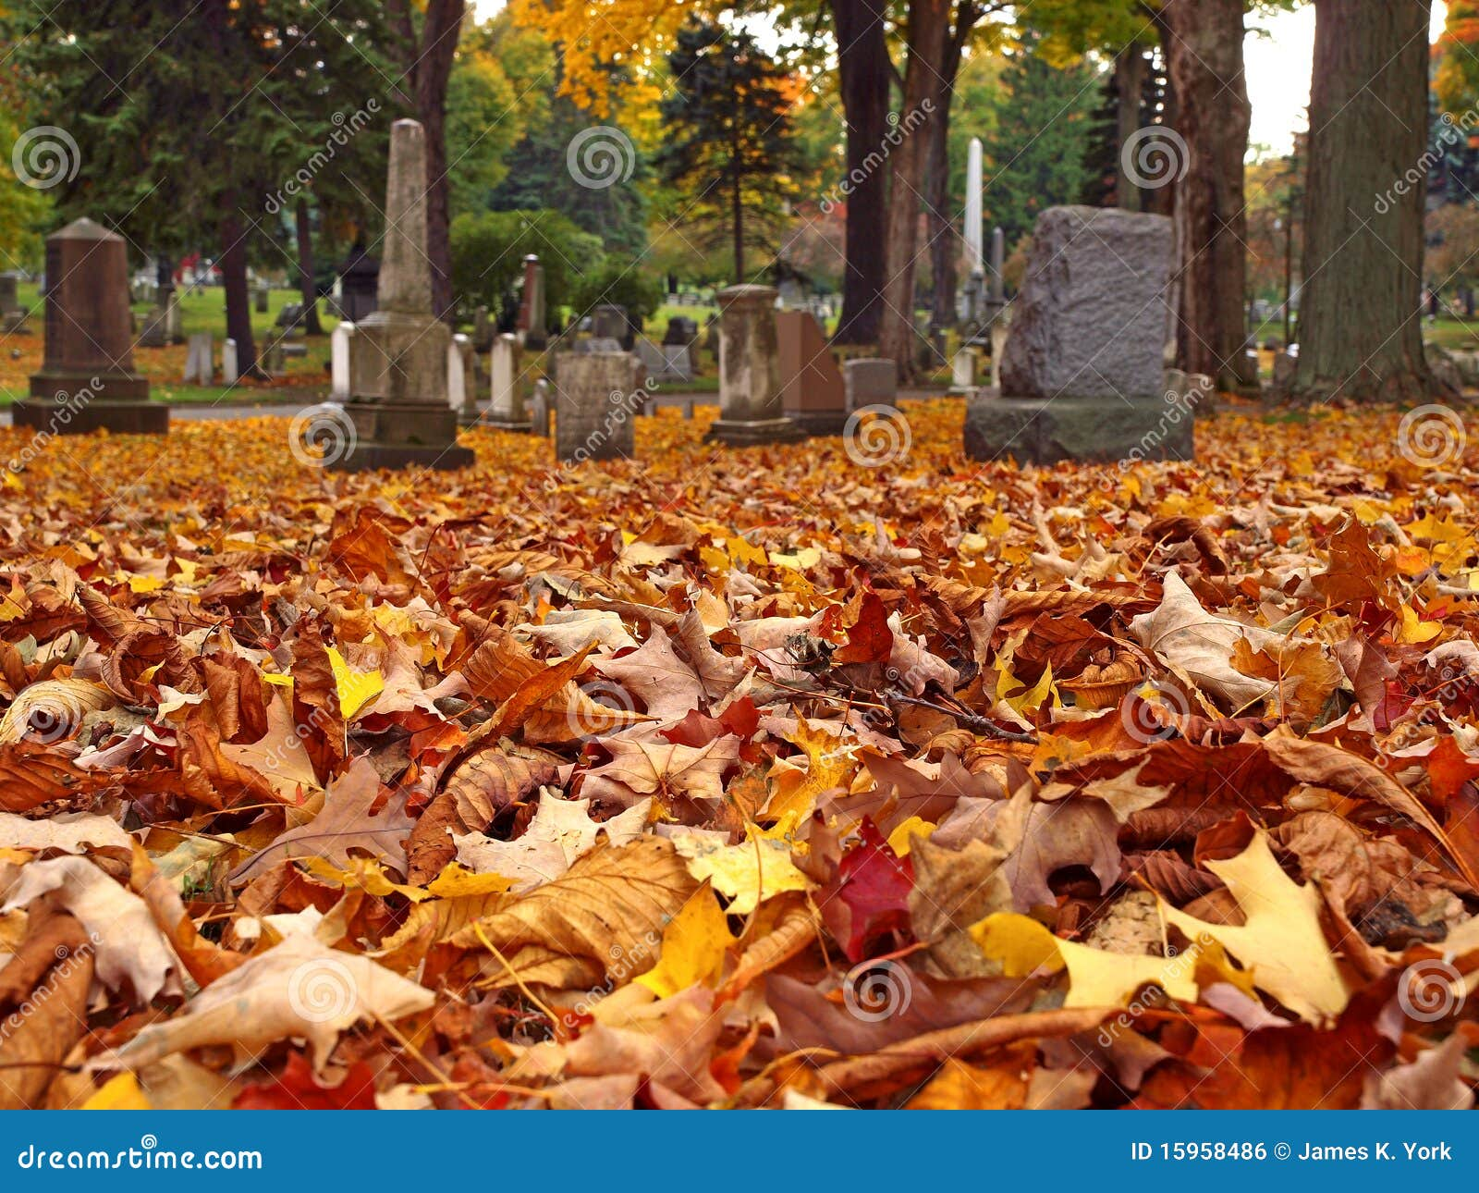
LAW UPDATES
LD 536, An Act to Provide Natural Organic Reduction Facilities for Maine Residents for the Conversion of Human Remains to Soil
The law became effective September 10, 2024. Organic Natural Reduction, also known as human composting, is the accelerated conversion of human remains into soil. Maine is the 12th state to legalize human composting. No facilities in Maine have been built for this purpose to date.
LD 1233, An Act Regarding the Maine State Cemetery Preservation Commission
The law now requires the cemetery preservation commission to investigate violations of the laws governing burying grounds and cemeteries.
The law authorizes the cemetery preservation commission to hire staff, create a web page on the State's publicly accessible website, prepare educational materials for distribution to municipalities and statewide cemetery associations, establish a grant program under which communities may apply for a grant for the restoration of burying grounds and cemeteries and submit legislation at the start of each session regarding the care, protection, and preservation of and access to burying grounds and cemeteries.
The bill also directs Data, Research, and Vital Statistics (DRVS) to increase the fee for a disposition permit by $5, which will be used to fund the operation of the Maine State Cemetery Preservation Commission.

Slide 3
RULEMAKING UPDATES
The Department will go through emergency rulemaking to include the $5.00 fee increase on the disposition permit in Chapter 1 of 10-146 CMR Department rule. Other changes to the rule will be done later as part of routine technical changes.
The Department is proposing routine technical changes to Chapter 4 of 10-146 CMR Department rule to align the rule with Maine law (22 MRS § 2706) and further specify the Department’s criteria for determining who may apply and whether an applicant has demonstrated a direct and legitimate interest in the records they wish to receive from the State Registrar. Changes include adding two categories of applicants who may demonstrate direct and legitimate interest: (1) healthcare practitioners seeking to update their patient records by requesting death certificates and (2) organizations and foundations in Maine administering funds. Another proposed change includes moving the entirety of Section 8B (Authorized Applicants) to Section 6A(4), to consolidate all aspects of direct and legitimate criteria within Section 6 and designate Section 8 to the Department’s conditions of data release for such records.

Slide 4
COMING IN 2025
FETAL DEATH MODULE
A new fetal death module will be coming in 2025. Currently, Fetal Deaths are a paper-based system.

Slide 5
RESOURCES
Staff listing https://www.maine.gov/dhhs/mecdc/public-health-systems/data-research/vital-records/edrs/medical-certifiers.html
Vital Records Public Forms https://www.maine.gov/dhhs/mecdc/public-health-systems/data-research/vital-records/forms/index.shtml
Access to DAVE https://www.maine.gov/dhhs/mecdc/public-health-systems/data-research/vital-records/edrs/medical-certifiers.html
Website for Municipal Clerks https://www.maine.gov/dhhs/mecdc/public-health-systems/data-research/vital-records/edrs/medical-certifiers.html
Online Indexes https://docuware.maine.gov/DocuWare/Platform/WebClient/

Slide 6
IT’S IMPORTANT TO STAY INFORMED!
REMINDERS
It is the responsibility of each city or town to make sure that:
City/towns have the most updated versions of the vital records staff listing and any vital records forms.
City/towns only issue vital records that occurred in your city/town. Place of event and residence. Do not file records that occurred out of the State of Maine.
All clerks, deputies, and assistant clerks use their own usernames and passwords to access the DAVE system.
Notify DRVS when a staff member is no longer working for your city or town or if you have updated your e-mail or mailing address.
Keep vital records or copies of vital records away from public viewing.
Keep your safety paper locked and secured when leaving each day.
Only allow access to your vault or place you store vital records to those who are authorized to issue them.
Read the portions of the municipal clerk's manual, training materials, and monthly newsletters that are provided on DRVS website.

Slide 7
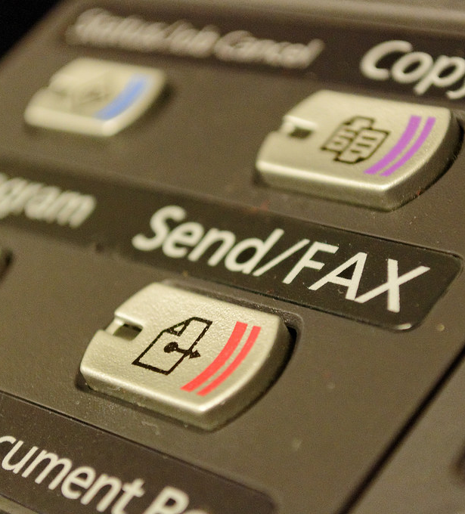
FAXING VITAL RECORDS
Faxes are secure provided that the Department or municipal clerk has verified the agency, business, or institution to which they are faxing the information. One of the reasons for fax security as opposed to the security of other Internet or mobile-based communications is that fax machines communicate via phone lines, not the Internet. Phone lines are more difficult to compromise than public internet and Wi-Fi connections, although, the fax may be intercepted, and the record may not go where intended.
The Department does not normally permit or allow any records, whether certified or non-certified, to be faxed to any individual, business, or institution, but there may be occasions on a case-by-case basis when a customer needs a record faxed to the airport or cruise line for travel, a new job, or housing. Municipal clerks may use their discretion for these types of cases. Prior to faxing any information, please be sure that an application, identification, proof of lineage, or a direct and legitimate interest (if applicable) has been provided and payment has been arranged

Slide 8
VERIFICATION PROCEDURE
If a vital record is requested, and the municipality does not have the record on file or is questioning the information on a vital record, municipal clerks may fax a verification request to the Department. The verification process has been established to ensure municipal clerks receive the quickest response possible from vital records staff.
Examples of the times when a verification request should be faxed to the Department are when there is a missing file date, spelling of the registrant's (or parent's) names on a record if there has been an adoption, or to check if a correction or a legal name change has been applied to the record.
If a customer is waiting and needs immediate assistance, please indicate so on the verification form. If a response is not provided within a reasonable amount of time, please contact Mary Motuzas at (207) 287-1910 or Mary.Motuzas@maine.gov.
The verification form and instructions may be found on the Department’s website for clerks at https://www.maine.gov/dhhs/mecdc/public-health-systems/data-research/vital-records/edrs/medical-certifiers.html The form needs to be completed to account for services provided by the Department.

Slide 9
DRVS ONLINE INDEX PORTAL Births from 1892 to September 1995 ▪ Deaths from 1892 to January 2011 ▪ Marriages from 1892 to January 2017
Data, Research, and Vital Statistics (DRVS) online indexes are intended to aid in locating the existence of a death, marriage, or birth record.
https://docuware.maine.gov/DocuWare
A username and password may be provided to municipal clerks or genealogists who hold a valid genealogist registration card issued by DRVS.
The portal is a good source to find out if DRVS has the record, where the record is filed, and to obtain the SFN in case you are asked to include it on any certified copies issued.
If you would like to access the portal or if you have misplaced your username and password, please contact DRVS via email at VitalRecords.DHHS@maine.gov or by calling (207) 287-5451.

Slide 10
TRUE ATTESTED COPIES
Periodically, municipal clerks will be asked to mail a “true attest copy” or “attested” of a birth, marriage, or death record to either the Department or another municipality.
To make a true attest copy of the record, simply photocopy the record onto plain white paper and type or write the statement “True Attest Copy”. The issuing officer will need to print and sign their name and title under the statement and provide the date the copy was made. Place the municipal seal next to the issuing official’s signature. For records that are a full page, the statement and signature should be done on the back of the record where it will not become part of the record when issued onto safety paper.
Example of a True Attested Copy
True Attest Copy
Signature: Christine Wolfe
Name and Title: Christine Wolfe, Municipal Clerk
City/Town: Town of Freeport
Date: 03/19/2023
(Emboss or place municipal seal by the true attest statement)
When issuing vital records from an attested copy, please be sure to cover the statement before issuing certified copies. A true attested copy is never notarized, it is only signed by the municipal clerk or the clerk’s authorized staff.

Slide 11
UNITED STATES DEPARTMENT OF VETERAN AFFAIRS (TOGUS) & VETERANS COPIES OF VITAL RECORDS
Municipal clerks may provide free certified copies of a public birth, death, or marriage record (see below paragraph) to applicants who indicate the requested record is to be used in determining eligibility for Veterans Administration benefits. The statute does not limit the number of free copies to just one. All certified copies issued for VA benefits must be stamped "FOR VA BENEFITS ONLY". In the event the birth, death, or marriage is considered a restricted record, please refer applicants to the Department to obtain a fee copy.
Public Record Defined. After 75 years from the date of birth for birth certificates, after 50 years from the date of death for fetal death certificates, after 25 years from the date of death for death certificates, after 50 years from the date of marriage for marriage certificates, and after 50 years from the registration of domestic partnerships, any person may obtain noncertified copies of these vital records under the department's rules. Certificates and records of birth, marriage, and death, including fetal death, created before 1892 are open to the public without restriction. All persons may purchase a copy on municipal letterhead, or a noncertified copy of a vital record created before 1892.
DAVE does track when a free veteran's copy has been issued when the service (birth veteran, death veteran, and marriage veteran) is selected. Municipal clerks may need to save any overrides if another copy of the same record is requested for veterans' benefits.
Notes:
Certificates of live births, deaths, and fetal deaths occurring at the federal facility, known as Togus, are filed directly with the Department in the DAVE system. Prior to the DAVE system, the Department forwarded paper copies of all live births, deaths, and fetal deaths received, to the clerk of the municipality where the parents of the child resided or the municipality where the decedent resided.

Slide 12
OUT OF STATE RECORDS
DO NOT ISSUE!
The only records you should have filed in your municipality are the place of the event or residence.

Slide 13
FRAUD PREVENTION
Require identification for all individuals requesting vital records.
Establish a phone policy for not releasing information over the phone.
Limit access to data and vital records (authorized personnel only) and follow “disclosure of Vital Records” laws.
Protect personally identifiable information such as written requests and applications. Mark the birth records deceased (if a resident of your municipality)
Request validation of reports and documents submitted before releasing a vital record or issuing a marriage license.

Slide 14
VITAL RECORDS APPLICATIONS
Applications should be available at the counter and on your website.
Applications must be gender-neutral.
Applications should contain the identification and supporting documentation that was provided to you to release a restricted record.
It is recommended that you write the order number down and the safety paper numbers used on the application when issuing from the DAVE system in case you get distracted so you can finish the order in DAVE later.
Applications must be retained for one year.

Slide 15
WHEN IN DOUBT – USE THE MATRIX

Slide 16
Remember- Anyone listed on a vital record can get that record.
This includes the parents and certifier on a birth record; the parents, informant, certifier, and funeral director on a death or fetal death record; and the parties, parties' parents, and person who solemnized the marriage on a marriage record.

Slide 17
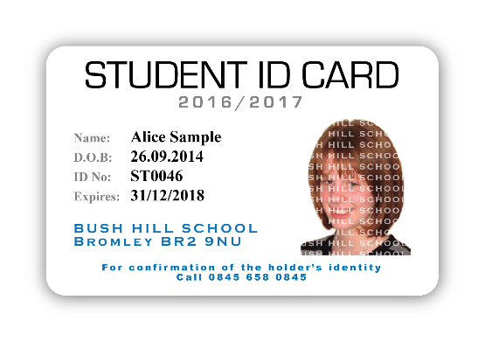
IDENTIFICATION
Identification documents presented by the applicant must be the original or a copy of a document that has been notarized. Such documentation must be acceptable by the municipal clerk or the Department and must include:
Government issued identification that includes a photograph; or
At least two alternate forms of identification; or
An alternative electronic process.
Don’t forget to write down the identification presented to you on the application!

Slide 18
DIRECT AND LEGITIMATE INTEREST
The following applicants may obtain restricted vital statistics data contained in a vital reports or records by demonstrating that such information is needed for the determination or protection of personal property rights:
Registrant or related individuals;
A surviving parent acting on behalf of a child who is a minor shall be entitled to the deceased parent(s) death certificate if their parental rights have not been terminated.
Genealogical researchers who hold a valid genealogical researcher identification card from the DRVS.
Others approved by the State Registrar who provide supporting documents of eligibility to determine they are qualified to receive such data.
Applicants demonstrating a direct and legitimate interest must present supporting documentation to determine the applicant’s eligibility to receive the requested data or record. The documentation must be an original document or a copy of the document that has been notarized.
Don’t forget to write down the documentation presented to you on the application!

Slide 19
ANNUAL TOWN REPORTS
It is unlawful for any employee of the State or of any municipality in the State to disclose data contained in such records, except as authorized in this section and except that a clerk of a municipality may cause to be printed in the annual town report the births reported within the year covered by the report, by number of births and location by city or town where the birth occurred, deaths reported within the year covered by the report, by date of death, name, age, and location by city or town where the death occurred, and marriages reported within the year covered by the report by names of parties and date of marriage. All other details of birth, marriage, divorce, or death may not be available to the public, except as specified in Department rules.

Slide 20
ADOPT A PHONE POLICY
Information on a vital record should never be verbally disclosed over the phone, regardless of if the record is considered public or restricted. Individuals requesting the information must be deemed eligible prior to receiving any information about a vital record.
Individuals requesting data or information contained in the annual town report should be referred to the municipality’s website or a printed version of the annual report.
Individuals requesting data or information from a public vital record should be encouraged to complete an application to obtain a non-certified copy of the vital record in question.
Researchers engaged in genealogical research who hold a valid researcher identification card should be encouraged to complete an application to obtain a non-certified copy of the vital record in question.
Municipal clerks may use their discretion if or when verifying a vital record is filed within their municipality. A municipal clerk must not disclose personally identifiable information contained in vital records or issue a copy of all or part of any such record unless the applicant is authorized to obtain a such record for a proper purpose or is authorized to obtain such data.

Slide 21
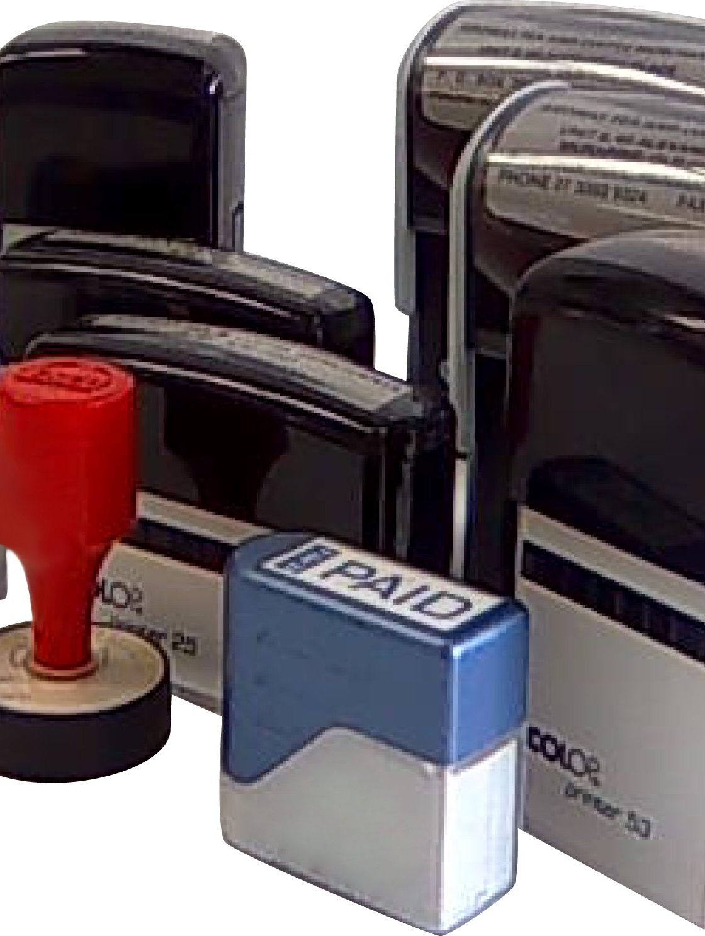
NON-CERTIFIED COPIES
Generally, noncertified copies are used for investigative research or genealogical purposes only.
A non-certified copy is a copy of a vital record issued onto blank white paper. The copy must be stamped or marked “NOT TO BE USED AS A LEGAL DOCUMENT”. This includes a “working copy” from DAVE.
A non-certified copy of a public vital record may be issued to applicants who complete an application or written request, present identification, and pay the required fee.
A non-certified copy of a restricted vital record may be issued to applicants who
complete an application or written request, present identification, pay the required fee,
and provide proof of lineage or their direct and legitimate interest in the record.
Individuals named on the record need only to complete an application or written request
and present identification.

Slide 22
CERTIFIED COPIES
A certified copy is a copy of a vital record issued onto safety paper (VS-31). The safety paper is
specially created with security measures with raised borders, prismatic type, and other safeguards
against fraudulent copying. Certified copies are considered for all purposes the same as the original and shall be prima facie evidence of the facts stated in the record.
A certified copy of a public or restricted vital record may be issued to applicants who complete an application or written request, present identification, pay the required fee, and provide proof of lineage or their direct and legitimate interest in the record. Individuals named on the record need only to complete an application or written request and present identification.

Slide 23
MUNICIPAL SEAL PLACEMENT AND CERTIFICATION
The signature of the municipal clerk, appointed deputy or assistant clerk, and the municipal seal on a certified copy or abstract of a record is a guarantee that it is a correct and authentic copy. Proofread all copies carefully. If errors are made, destroy the copy, and start over. There must not be any strikeovers, erasures, correction fluid, or tape, on a certified copy.
Certify the copy with the issuing clerk’s signature and typewritten or printed name and title, the date the copy is issued, and the municipalities raised seal. Each municipality should have a municipal seal for use in making certifications.
The municipal seal should be placed near the bottom of the certified copy but should not cover the signature or date issued to ensure the information completed by the issuing clerk is legible on any certified copy issued.
An ink signature is preferable, but a facsimile signature (rubber stamp) may be used to facilitate the process in offices where the municipal clerk or deputy clerk may not always be present. In situations when a facsimile signature is used, the person issuing the copy should put their initials next to the stamped signature.
Protect all municipal stamps and seals against unauthorized use by securing them in a locked location, along with safety paper.

Slide 24
MASKING INFORMATION ON PAPER RECORDS
Certain paper-based records have a section marked “For Medical and Health Use Only”, “For Statistical Purposes Only”, “Confidential: This Information Will Not Appear on Certified Copies of the Record,” etc.
Municipal clerks should always redact or mask this section before photocopying the record. The data in this section is for statistical use only and must not appear on copies. Some records have a section marked “Confidential Medical Information”; this should be masked except when making copies for a person who can demonstrate a direct and legitimate interest in the record. The marital status of the mother on a birth certificate must be masked and must not appear on any copy (certified or non-certified).

Slide 25
TYPING ABSTRACTS
Try to avoid issuing abstracts of vital records if the original record is available to be photocopied. Many Federal or State agencies will not accept abstracts. Abstracts will typically need to be issued for vital records occurring from 1892 to 1955 when clerks mostly recorded vital events in ledger books and before the Department changed the format and reporting process in 1956.
The process, paper, and approval of all forms, formats, and procedures used to issue certified copies or abstracts (VS-10, VS-20, or VS-30) must be provided and approved by the State Registrar. The approved forms are in the DAVE system under the Forms/Print Forms tab, and they are printed on the BLANK VS-30 safety paper. Pre-printed abstracts are no longer valid.
When typing an abstract, please be sure to enter the data or information exactly as it appears on the original vital record. In the event an amendment or correction has been done to a vital record, please remember to include any amendments/correction notations (or deceased watermarks) that appear on the original record. Please feel free to contact the Department with any questions.

Slide 26
REDACTING INFORMATION
On occasion, a municipal clerk may be asked to “leave off or mask” the cause of death section or the social security number on a death record or information on other vital records. These types of requests from entitled individuals are reviewed on a case-by-case basis and are done only by typing an abstract.
The data or information requested to be left off, masked, or redacted on an abstract must contain chevrons <<<<<<<>>>>>>>> to be consistent with the electronic registration systems, if or when data on a vital record is missing. The abstract must then be copied onto safety paper (VS-31).
The minimum content that must appear on all certified abstracts can be found on pages 29-30 in the “General Portion” of the municipal clerk’s handbook on DRVS website at https://www.maine.gov/dhhs/mecdc/public-health-systems/data-research/vital-records/edrs/medical-certifiers.html.

Slide 27
ISSUING COPIES OF RECORDS PRIOR TO 1892 (Not issued on safety paper)
Certificates and records of birth, marriage, and death, including fetal death, created prior to January 1, 1892, are open to the public without restriction. All persons may purchase a copy on municipal letterhead, or a noncertified copy of a vital record created prior to 1892. "Hands-on" access or inspection of original, paper-based records or indexes shall not be permitted if there is an alternative method that may be used.
When duplicating a record from an older book, please keep the following in mind:
Copy the information verbatim as it appears on the record. Do not leave out or add a single letter even if there are obvious errors that anyone can recognize.
Describe the book (title) which contains the record and give the page number of the record.
If the record does not provide a date of filing, enter the month and year.
Never issue records occurring before 1892 on safety paper or use the VS-10, VS-20, or VS-30 abstract form. Please refer to the example on pages 30-31in the “General Portion” of the municipal clerk’s handbook on DRVS website at https://www.maine.gov/dhhs/mecdc/public-health-systems/data-research/vital-records/edrs/medical-certifiers.html.

Slide 28
PRESERVATION OF PAPER RECORDS
Maine State Archives 17 Elkins Ln, Augusta, ME 04333-0084 (207) 287-5790 maine.archives@maine.gov
Vital records are permanent records and must be preserved carefully. Original, paper records must be handled in accordance with guidelines designed to protect the physical integrity and condition of the records. Preserve records by placing them in binders or containers made for the purpose to protect and preserve the records from deterioration, mutilation, loss, or destruction. Keep paper records in chronological order by type of record and date of the event so they are easy to find when requested. File records back immediately after they have been issued to avoid any possible damage or misplacement of the record. "Hands-on" access or inspection of original, paper-based records or indexes should not be permitted to genealogists if there is an alternative method that may be used. Each municipality should have a dedicated storage area, or a fireproof safe/vault, to file and preserve all vital records. Access to the dedicated area or vault where vital records are stored should only be permitted to the municipal clerk, deputy clerk, or assistant clerk, who is authorized to issue vital records.
The ideal conditions for storing paper records that are in regular use are a constant temperature of about 65 degrees F and a relative humidity of about 40 percent. Average conditions for storing paper records are temperatures of 90 degrees with a relative humidity of 40 – 50%. Not many municipalities will have temperature and humidity-controlled storage space available. Although, all should be able to provide storage space which is adequate, if not ideal. Keep records out of hot attics, damp basements, and other dirty and dusty places. Watch for bookworms, silverfish, and other insects, which eat paper. The enemies of paper are heavy use, heat, moisture, dust, insects, and extrinsic acidity.
Vital records are permanent records, and municipal clerks should protect them from hazards as much as possible. Municipal clerks should not attempt to repair damaged records themselves. Above all, do not use cellophane tape to repair tears. It soon becomes brittle and peels off leaving a permanent brown stain on the record. Minor tears may be repaired with mending tissue and library paste, only if it is possible to do so without covering information on the record, or with the special transparent book-mending tapes.
Very old books and records that are damaged should receive expert attention. Old records may be microfilmed, scanned, or photocopied to produce working copies that may be used while the originals are safely stored in the vault. Broken bindings can be replaced, and damaged sheets laminated. This is rather expensive work and will need to be considered in the municipalities budget.

Slide 29
RETENTION OF PAPER RECORDS
Paper vital records may not be destroyed or otherwise disposed of by any local government official, except as provided by the records retention schedule established by the State Archivist. Records that have been determined to possess archival value must be preserved by the municipality. Contact the records management services at the Maine State Archives for guidance on the disposition of older ancillary records such as premarital medical examination forms, waivers of premarital medical examinations, and waivers of the 3-day waiting period between the filing of marriage intentions and the issue of license. It is recommended that a record be made, by year, of the items disposed of and the nature of the disposition.
10-146 Department Rule, Chapter 11 https://www.maine.gov/sos/cec/rules/10/chaps10.htm#146 states “when an authorized reproduction of a vital record has been properly prepared, by photographic, electronic, or other processes, by the State Registrar and when all steps have been taken to ensure the continued preservation of the information, the record from which such authorized reproduction was made may be disposed of by the State Registrar. Such record may not be disposed of, however, until the quality of the authorized reproduction has been tested to ensure that acceptable certified copies can be issued and until a security copy of the document has been placed in a secure location and removed from the building where the authorized reproduction is housed. Such security copy shall be maintained in such a manner to ensure that it can replace the authorized reproduction should the authorized reproduction be lost or destroyed.”

Slide 30
VAULT STORAGE FOR PERMANENT RECORDS
Each local government shall provide a fireproof safe or vault for the preservation of all records that must be retained permanently but are not required for business purposes. The official having responsibility for those records shall deposit them in the safe or vault where those records must be kept except when required for use.
Vault should be either ground-supported (i.e., capable of standing on its own if the building around it collapses) or located within a fire-resistive building (one that will not suffer structural collapse even if its contents is completely consumed). Walls of the building may only be used as walls of the vault if the building is fire resistive.
The vault should be planned, and its construction supervised by a registered engineer or architect. Its walls may only be pierced for necessary services, and 29-255 Chapter 10 page 8 should not be open to any type of shaft. Floor and roof may not be pierced. All walls, floor (if vault is structure-supported rather than ground-supported), and door should at a minimum meet 4-hour fire resistance standards per a nationally recognized standards organization. The vault door may not be a standard “fire door” or other design not specifically intended for vault use. The door locking mechanism should provide for escape by a person accidentally locked inside.
No combustible materials may be used in the vault’s construction, including in any necessary damp-proofing. A ventilating system that conforms to nationally recognized standards should be provided, and all services (electrical, heating, etc.) should conform to national and local codes. Open flame heating shall not be used under any circumstances.
The vault should be installed by qualified and experienced personnel, in conformity with its manufacturer’s requirements. “Fireproof” cabinets or other portable fire-resistant records storage equipment may not be substituted for a properly designed and constructed vault.

Slide 31
STATE SHARE OF VITAL RECORDS
Municipalities must submit their Municipal Revenue Reporting and the State Share of Vital Records Fee in a format and schedule as determined by the Department. A fillable form with calculations has been developed for this purpose.
The SSVR reporting form, instructions for completing the form, as well as the customer number list and reporting periods for municipal clerks, may be found in DAVE under the Forms/Print Forms tab. Please contact Sue Paradis at (207) 287-5471 or susan.paradis@maine.gov if you have any questions.

Slide 32
QUESTIONS?

